Slide 1

USport
Play. Connect. Learn.

Slide 2
Team
Abdulmalek Abulgasem
Ayush Budhwani
D'Anne Anthony
Evan Scott
Franklin Barr

Slide 3
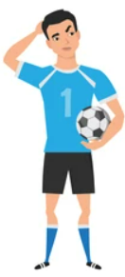
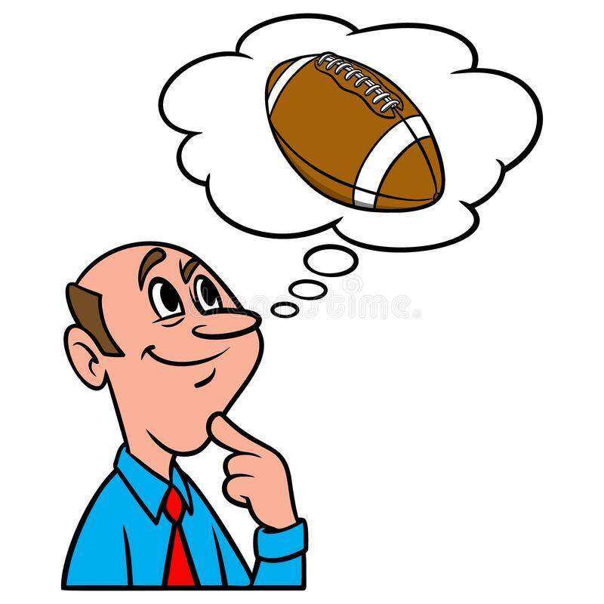
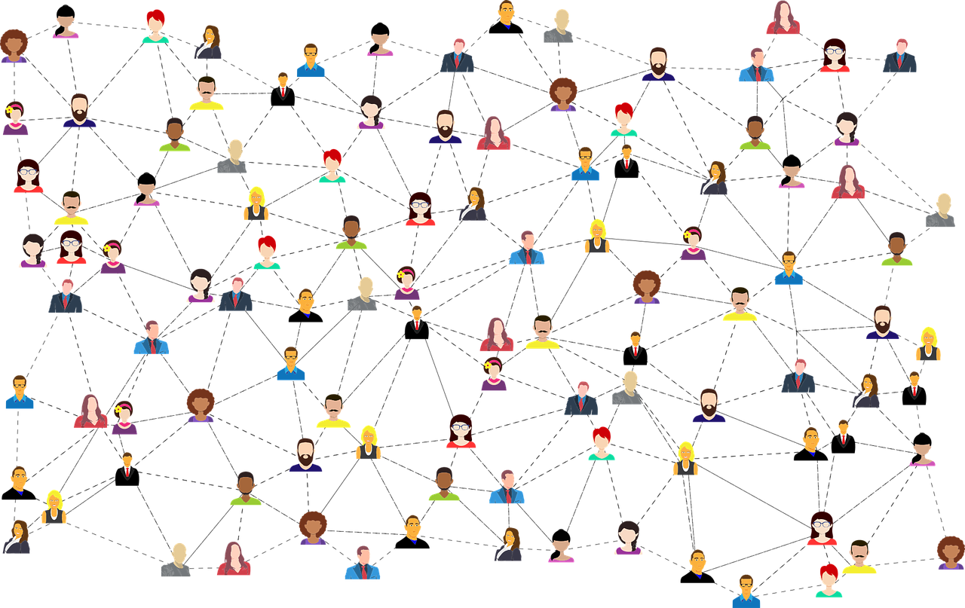
Problems
How to network with players & trainers to improve or learn a new sports skill?
How to find players interested to playing football?
How to find other players to compete with?

Slide 4
Purpose of Software System & Targeted users
Purpose
Targeted users
A web platform that helps connect sports enthusiasts with players for games and connect users with trainers.
Sports enthusiasts
Trainers
College students
Tourists

Slide 5
Description
Connects like-minded players to games, tournaments, and coaching.
Offers a variety of sports options for users to search and filter by location, skill level, and time.
Provides a social aspect for users to connect with other users who share similar interests, send messages, follow activity, and join/create groups.
Encourages healthy habits and physical activities, allowing users to track their progress, set goals, and stay motivated.
Notes:
USport is a web app that helps people connect with other people with similar sports interests. People can also connect with trainers to improve their skills in a sport of their choosing.
USport will help people who have a hard time finding someone to play sports with such Tourists and College Students and connect them with random people for a game anytime they want.
It will also help to develop good habit of keeping oneself's body healthy by making them able to join a game from a click of a button.

Slide 6





Technology Stack
Frontend: React, CSS, Material UI
Middle-tier: Java
Database: PostgreSQL

Slide 7
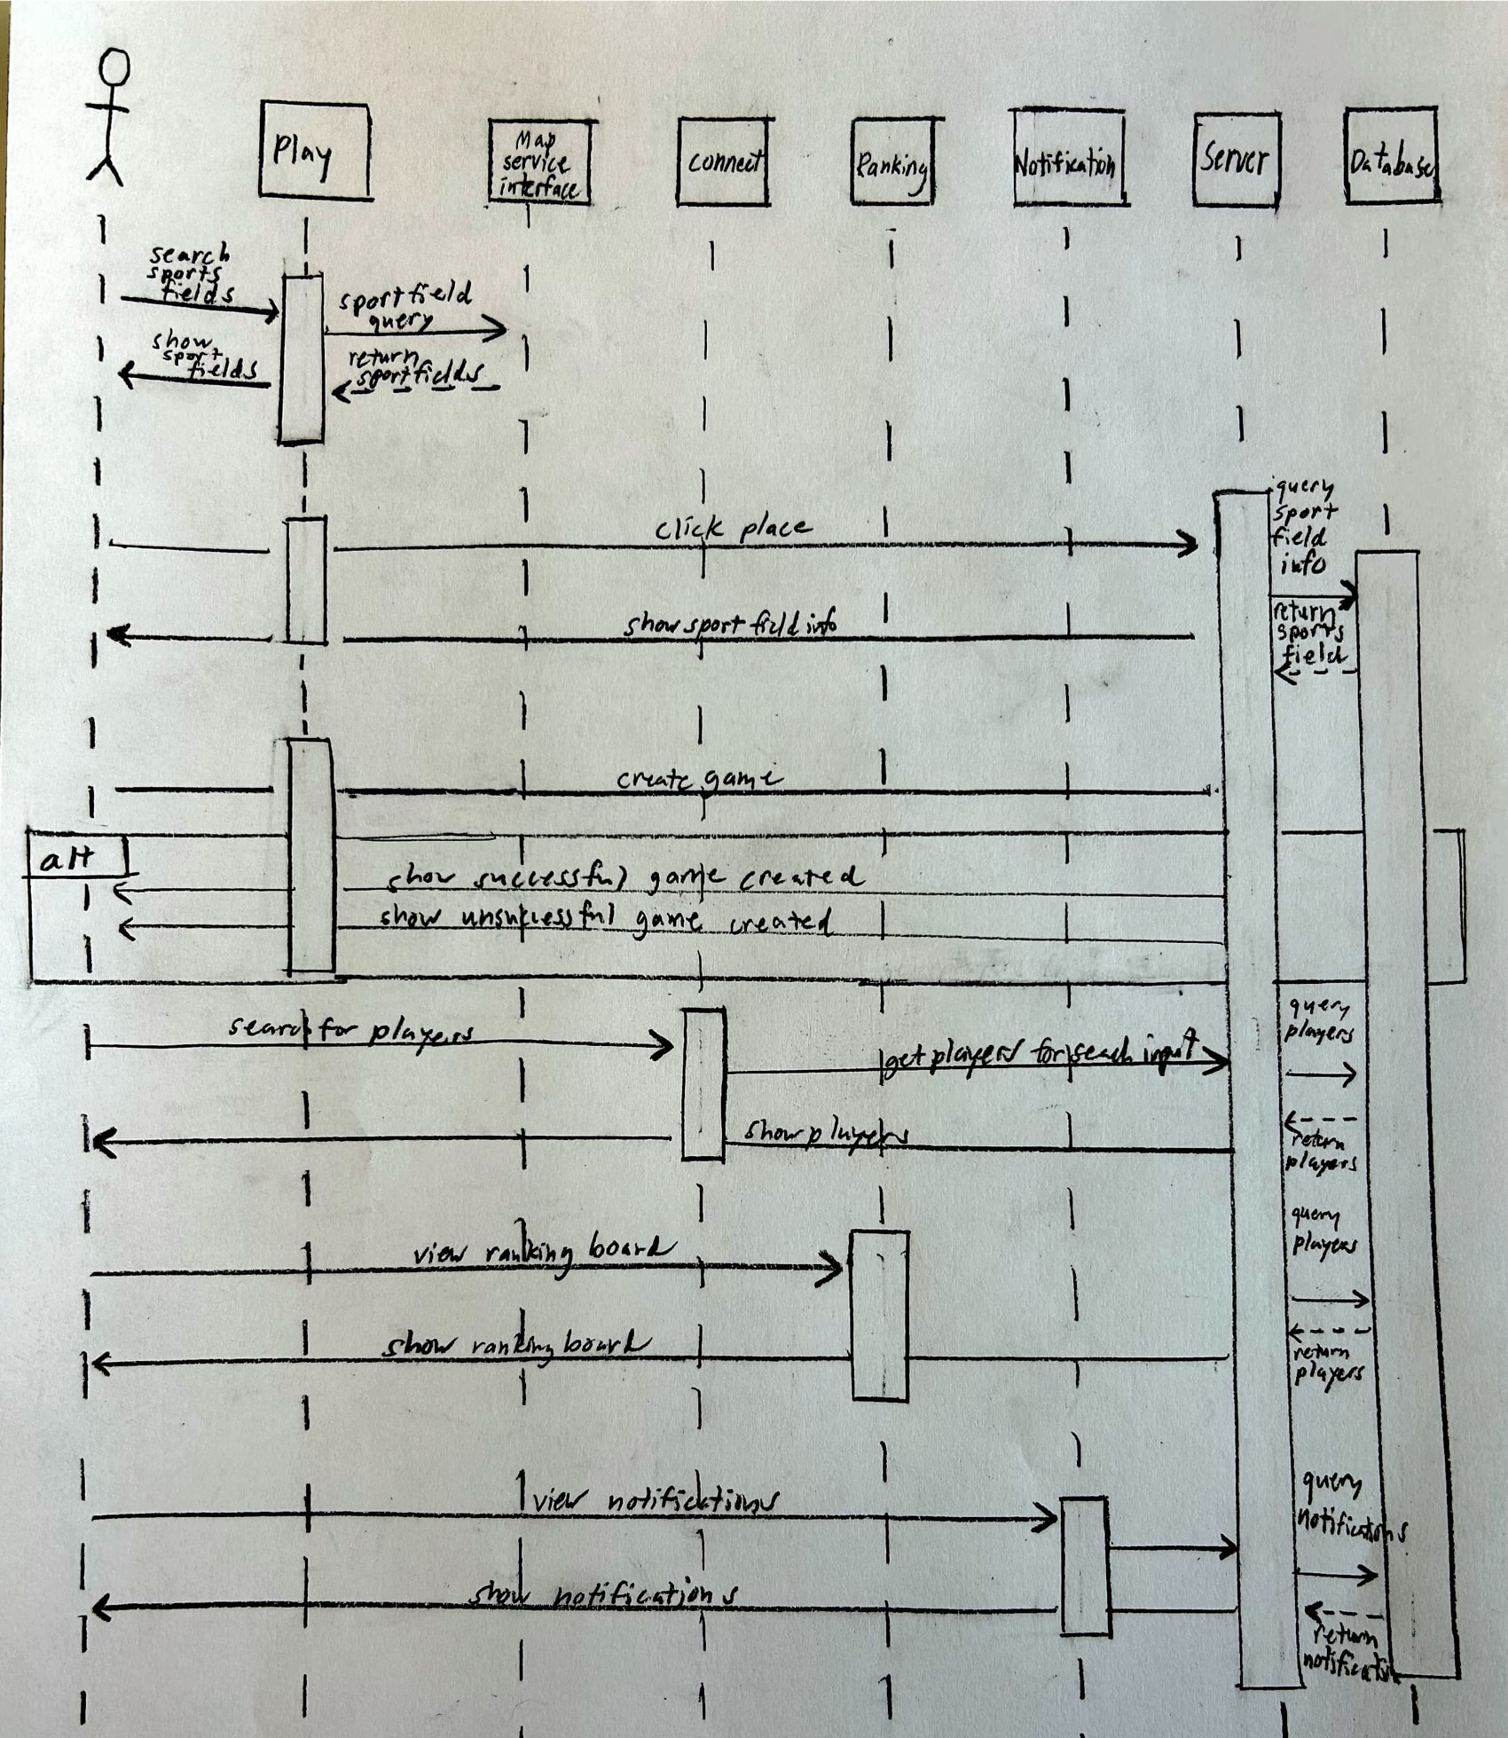
UML Sequence Diagram

Slide 8
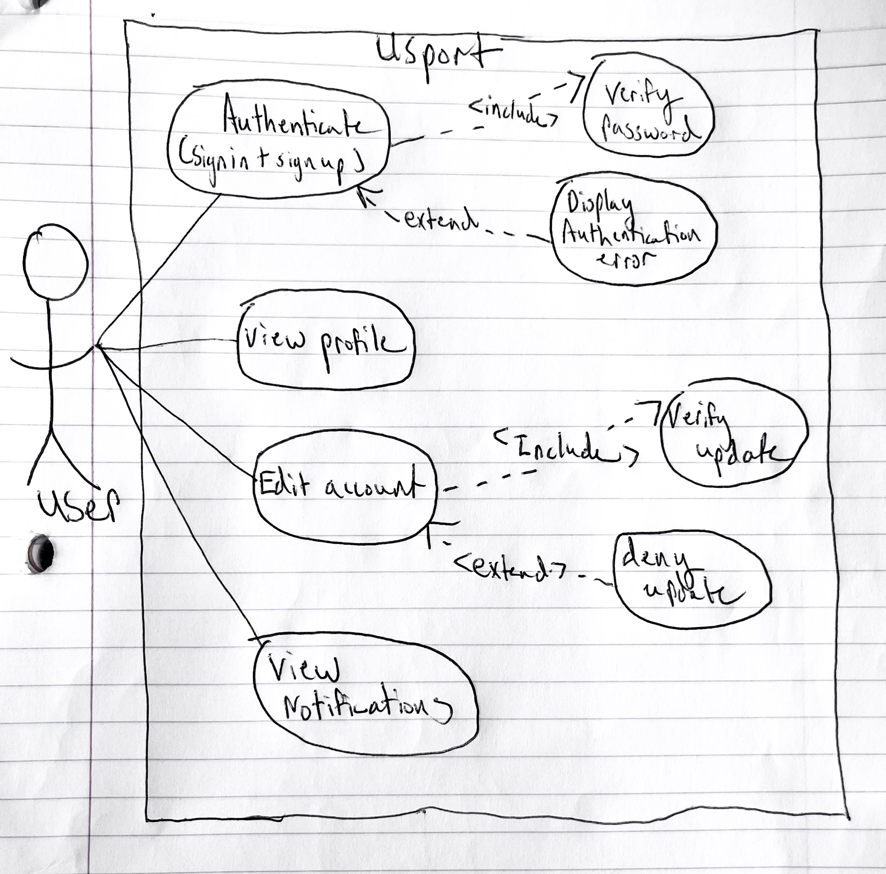
UML Use Case Diagram 1

Slide 9
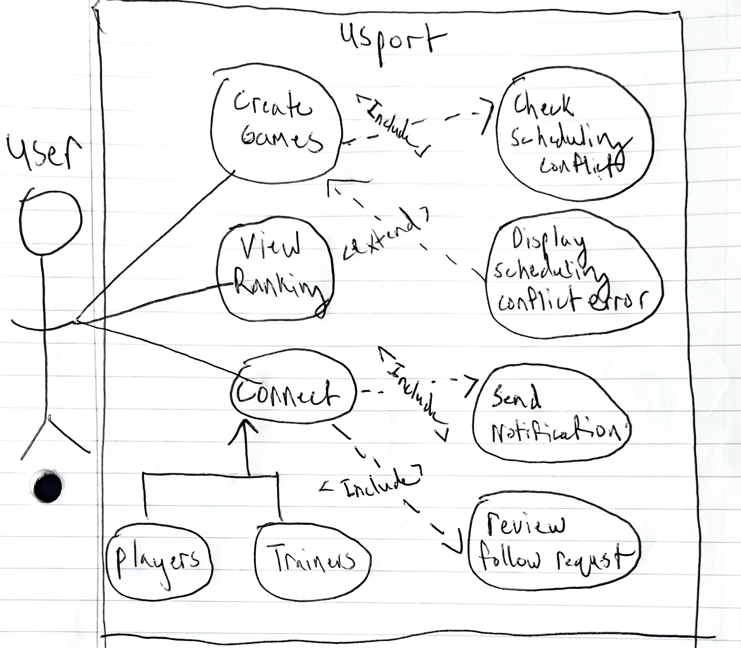
UML Use Case Diagram 2

Slide 10
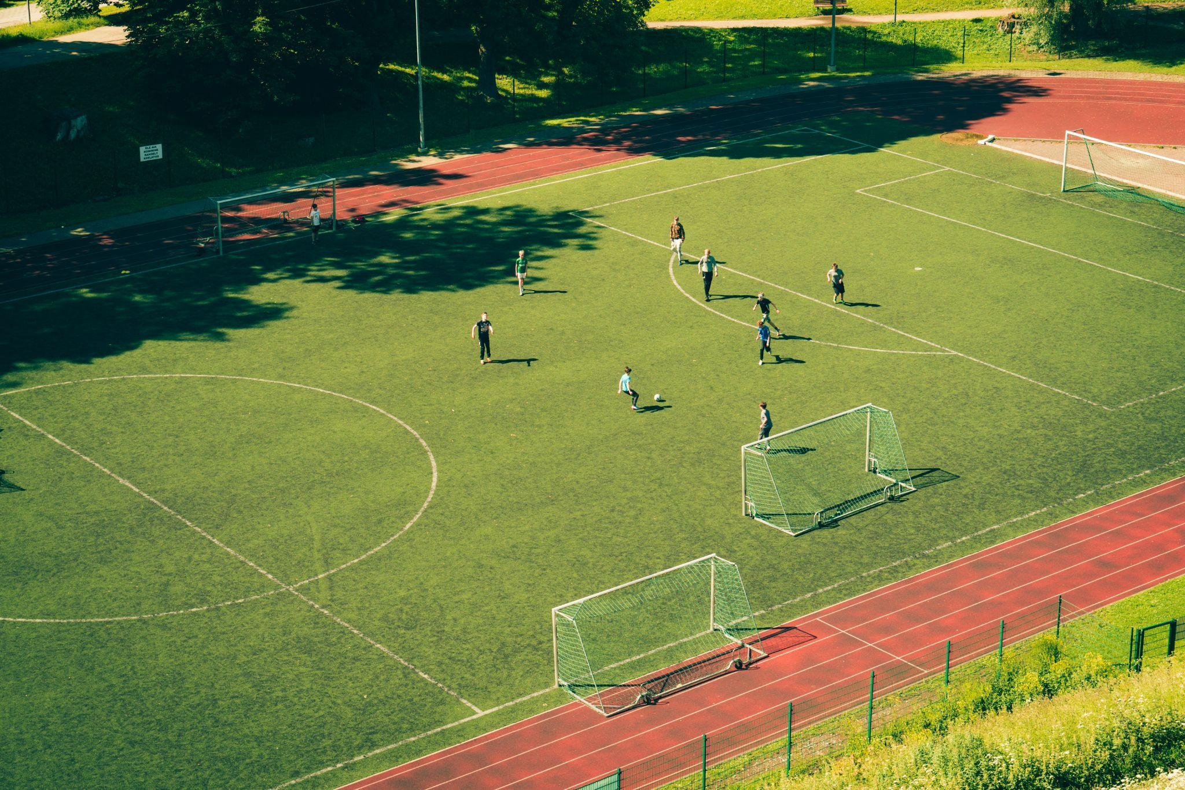
Demo

Slide 11
Conclusion

Slide 12
Thank you!

